Slide 1
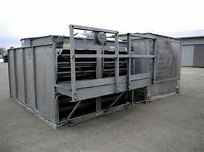
Legionnaires in Eastlake
Ongoing disease investigation

Slide 2
What is Legionaries Disease?
A respiratory disease caused by Legionella bacteria
Legionnaires’ disease is very similar to other types of pneumonia, symptoms include:
Cough
Shortness of breath
Fever
Muscle aches
Headaches

Slide 3
Legionnaires Disease
About one out of every 10 people who get sick from Legionnaires’ disease will die.
Legionella is found naturally in fresh water environments, like lakes and streams, but can become a health concern in human-made water systems.
Keeping Legionella out of water systems in buildings is key to preventing infection.

Slide 4
How to get Legionella
Inhale aerosolized water containing bacteria

Slide 5
Risk Factors
Smoking. Smoking damages the lungs, making you more susceptible to all types of lung infections.
Have a weakened immune system as a result of HIV/AIDS or certain medications, especially corticosteroids and drugs taken to prevent organ rejection after a transplant.
Have a chronic lung disease such as emphysema or another serious condition such as diabetes, kidney disease or cancer.
Are 50 years of age or older.

Slide 6
First Case
On 8/23/16, LCGHD notified of case of Legionella at Eastlake CNC facility. A Cleveland resident, smoker in his 50’s, passed away from the disease.
On 8/25/16, 2 sanitarians and the plumbing inspector walked through facility, testing water for ph and chlorine residual. All testing and visual inspection items were in correct parameters.

Slide 7
Second/Third Case
September 26, two new cases were discovered at businesses neighboring the original case.
September 30, 2 sanitarians and the plumbing inspector walked through second facility, testing water for pH and chlorine residual. All testing and visual inspection items were in correct parameters.

Slide 8
Second/Third Case
On October 4th, walk through of 3rd location, 2 sanitarians and the plumbing inspector walked through facility, testing water for pH and chlorine residual. All testing and visual inspection items were in correct parameters, except for cooling tower sump which had cloudy water and possible biofilm.

Slide 9
Outbreak?
Legionellosis outbreaks occur when two or more people are exposed to Legionella and get sick in the same place at about the same time.

Slide 10
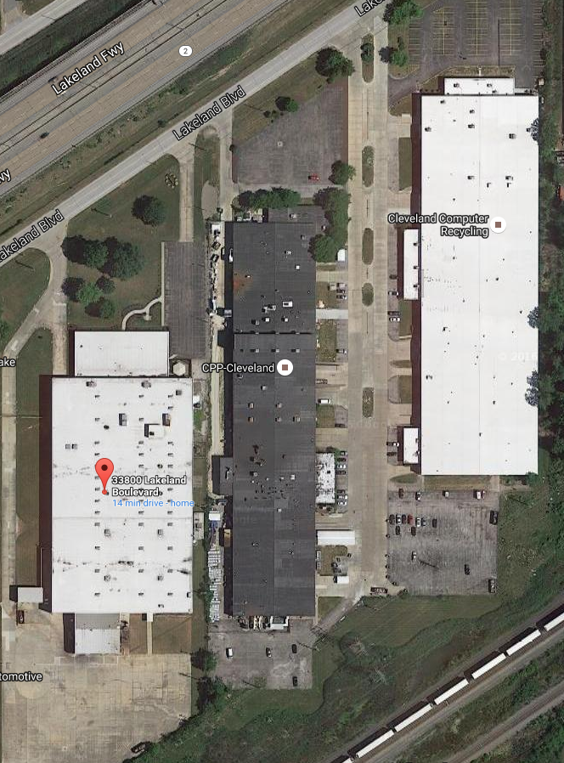
2
3
1

Slide 11
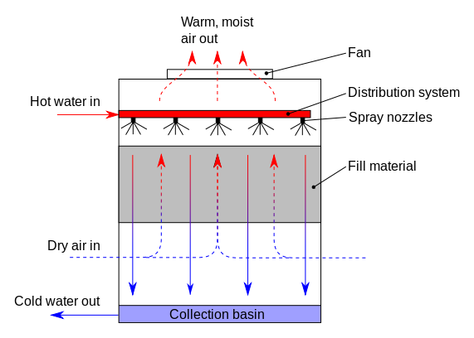
Cooling Tower Operation

Slide 12
Outcomes
Cooling tower sampling results confirmed presence of legionella in cooling tower water .
11/9/16 Tower was sanitized and resampled. Results showed absence of bacteria.

Slide 13
